Slide 1
Usability
Harvinder S Jabbal
CSIS, Work Integrated Learning Programs

Slide 2
SEZG651/ SSZG653
Software Architectures
Module 2-CS05B

Slide 3
Chapter Outline
What is Usability?
Usability General Scenario
Tactics for Usability
A Design Checklist for Usability
Summary

Slide 4
What is Usability?
Usability is concerned with how easy it is for the user to accomplish a desired task and the kind of user support the system provides.
Over the years, a focus on usability has shown itself to be one of the cheapest and easiest ways to improve a system’s quality (or, more precisely, the user’s perception of quality).

Slide 5
What is Usability?
Usability comprises the following areas:
Learning system features.
Using a system efficiently.
Minimizing the impact of errors.
Adapting the system to user needs.
Increasing confidence and satisfaction.

Slide 6
Usability General Scenario
Portion of Scenario | Possible Values
Source | End user, possibly in a specialized role
Stimulus | End user tries to use a system efficiently, learn to use the system, minimize the impact of errors, adapt the system, or configure the system
Environment | Runtime or configuration time
Artifacts | System or the specific portion of the system with which the user is interacting.
Response | The system should either provide the user with the features needed or anticipate the user’s needs.
Response Measure | One or more of the following: task time, number of errors, number of tasks accomplished, user satisfaction, gain of user knowledge, ratio of successful operations to total operations, or amount of time or data lost when an error occurs.

Slide 7
Sample Concrete Usability Scenario
The user downloads a new application and is using it productively after two minutes of experimentation.

Slide 8
Goal of Usability Tactics
Researchers in human-computer interaction have used the terms "user initiative," "system initiative," and "mixed initiative" to describe which of the human-computer pair takes the initiative in performing certain actions and how the interaction proceeds.
Usability scenarios can combine initiatives from both perspectives.
We use this distinction between user and system initiative to discuss the tactics that the architect uses to achieve the various scenarios.

Slide 9
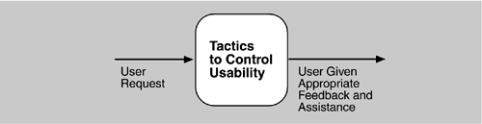
Goal of Usability Tactics

Slide 10
Usability Tactics

Slide 11
Support User Initiative
Cancel: the system must listen for the cancel request; the command being canceled must be terminated; resources used must be freed; and collaborating components must be informed.
Pause/Resume: temporarily free resources so that they may be re-allocated to other tasks.
Undo: maintain a sufficient amount of information about system state so that an earlier state may be restored, at the user’s request.
Aggregate: ability to aggregate lower-level objects into a group, so that a user operation may be applied to the group, freeing the user from the drudgery.

Slide 12
Support System Initiative
Maintain Task Model: determines context so the system can have some idea of what the user is attempting and provide assistance.
Maintain User Model: explicitly represents the user's knowledge of the system, the user's behavior in terms of expected response time, etc.
Maintain System Model: system maintains an explicit model of itself. This is used to determine expected system behavior so that appropriate feedback can be given to the user.

Slide 13
Design Checklist for Usability
Allocation of Responsibilities | Ensure that additional system responsibilities have been allocated, as needed, to assist the user in learning how to use the system efficiently achieving the task at hand adapting and configuring the system recovering from user and system errors

Slide 14
Design Checklist for Usability
Coordination Model | Determine whether the properties of system elements’ coordination—timeliness, currency, completeness, correctness, consistency—affect how a user learns to use the system, achieves goals or completes tasks, adapts and configures the system, recovers from user and system errors, increases confidence and satisfaction. For example, can the system respond to mouse events and give semantic feedback in real time? Can long-running events be canceled in a reasonable amount of time?

Slide 15
Design Checklist for Usability
Data Model | Determine the major data abstractions that are involved with user-perceivable behavior. Ensure these major data abstractions, their operations, and their properties have been designed to assist the user in achieving the task at hand, adapting and configuring the system, recovering from user and system errors, learning how to use the system, and increasing satisfaction and user confidence For example, the data abstractions should be designed to support undo and cancel operations: the transaction granularity should not be so great that canceling or undoing an operation takes an excessively long time.

Slide 16
Design Checklist for Usability
Mapping Among Architectural Elements | Determine what mapping among architectural elements is visible to the end user (for example, the extent to which the end user is aware of which services are local and which are remote). For those that are visible, determine how this affects the ways in which, or the ease with which the user will learn how to use the system, achieve the task at hand, adapt and configure the system, recover from user and system errors, and increase confidence and satisfaction.

Slide 17
Design Checklist for Usability
Resource Management | Determine how the user can adapt and configure the system’s use of resources. Ensure that resource limitations under all user-controlled configurations will not make users less likely to achieve their tasks. For example, attempt to avoid configurations that would result in excessively long response times. Ensure that the level of resources will not affect the users’ ability to learn how to use the system, or decrease their level of confidence and satisfaction with the system.

Slide 18
Design Checklist for Usability
Binding Time | Determine which binding time decisions should be under user control and ensure that users can make decisions that aid in usability. For example, if the user can choose, at run-time, the system’s configuration, or its communication protocols, or its functionality via plug-ins, you need to ensure that such choices do not adversely affect the user’s ability to learn system features, use the system efficiently, minimize the impact of errors, further adapt and configure the system, or increase confidence and satisfaction.

Slide 19
Design Checklist for Usability
Choice of Technology | Ensure the chosen technologies help to achieve the usability scenarios that apply to your system. For example, do these technologies aid in the creation of on-line help, training materials, and user feedback collection. How usable are any of your chosen technologies? Ensure the chosen technologies do not adversely affect the usability of the system (in terms of learning system features, using the system efficiently, minimizing the impact of errors, or adapting/configuring the system, increase confidence and satisfaction).

Slide 20
Summary
Architectural support for usability involves both allowing the user to take the initiative in circumstances such as cancelling a long running command, undoing a completed command, and aggregating data and commands.
To predict user or system response, the system must keep a model of the user, the system, and the task.

Slide 21
Other Quality Attributes

Slide 22
Chapter Outline
Other Important Quality Attributes
Other Categories of Quality Attributes
Software Quality Attributes and System Quality Attributes
Using Standard Lists of Quality Attributes
Dealing with “X-ability”
Summary

Slide 23
Other Important Quality Attributes
Variability: is a special form of modifiability. It refers to the ability of a system and its supporting artifacts to support the production of a set of variants that differ from each other in a preplanned fashion.
Portability: is also a special form of modifiability. Portability refers to the ease with which software that built to run on one platform can be changed to run on a different platform.
Development Distributability: is the quality of designing the software to support distributed software development.

Slide 24
Other Important Quality Attributes
Scalability: Horizontal scalability (scaling out) refers to adding more resources to logical units such as adding another server to a cluster. Vertical scalability (scaling up) refers to adding more resources to a physical unit such as adding more memory to a computer.
Deployability: is concerned with how an executable arrives at a host platform and how it is invoked.
Mobility: deals with the problems of movement and affordances of a platform (e.g. size, type of display, type of input devices, availability and volume of bandwidth, and battery life).

Slide 25
Other Important Quality Attributes
Monitorability: deals with the ability of the operations staff to monitor the system while it is executing.
Safety: Software safety is about the software’s ability to avoid entering states that cause or lead to damage, injury, or loss of life, and to recover and limit the damage when it does enter into bad states. The architectural concerns with safety are almost identical with those for availability (i.e. preventing, detecting, and recovering from failures).

Slide 26
Other Categories of Quality Attributes
Conceptual Integrity: refers to consistency in the design of the architecture. It contributes to the understandability of the architecture. Conceptual integrity demands that the same thing is done in the same way through the architecture.
Marketability: Some systems are marketed by their architectures, and these architectures sometimes carry a meaning all their own, independent of what other quality attributes they bring to the system (e.g. service-oriented or cloud-based).

Slide 27
Other Categories of Quality Attributes
Quality in Use: qualities that pertain to the use of the system by various stakeholders. For example
Effectiveness: a measure whether the system is correct
Efficiency: the effort and time required to develop a system
Freedom from risk: degree to which a product or system affects economic status, human life, health, or the environment

Slide 28
Software Quality Attributes and System Quality Attributes
Physical systems, such as aircraft or automobiles or kitchen appliances, that rely on software embedded within are designed to meet a whole other litany of quality attributes: weight, size, electric consumption, power output, pollution output, weather resistance, battery life, and on and on.
The software architecture can have a substantial effect on the system’s quality attributes.

Slide 29
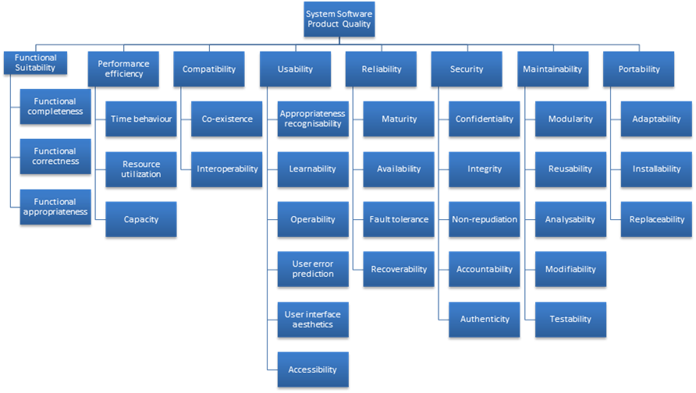
Standard Lists of Quality Attributes
ISO/IEC FCD 25010 Product Quality Standard

Slide 30
Standard Lists of Quality Attributes
Advantages:
Can be helpful checklists to assist requirements gatherers in making sure that no important needs were overlooked.
Can serve as the basis for creating your own checklist that contains the quality attributes of concern in your domain, your industry, your organization, your products, …

Slide 31
Standard Lists of Quality Attributes
Disadvantages:
No list will ever be complete.
Lists often generate more controversy than understanding.
Lists often purport to be taxonomies. But what is a denial-of-service attack?
They force architects to pay attention to every quality attribute on the list, even if only to finally decide that the particular quality attribute is irrelevant to their system.

Slide 32
Dealing with “X-ability”
Suppose you must deal with a quality attribute for which there is no compact body of knowledge, e.g. green computing.
What do you do?
Model the quality attribute
Assemble a set of tactics for the quality attribute
Construct design checklists

Slide 33
Summary
There are many other quality attributes than the seven that we cover in detail.
Taxonomies of attributes may offer some help, but their disadvantages often outweigh their advantages.
You may need to design or analyze a system for a “new” quality attribute. While this may be challenging, it is doable.

